Slide 1

A
PRESENTATION ON
“ONLINE EVALUATION SYSTEM”
SUBMITTED TO
COMPUTER SCIENCE AND ENGINEERING
FACULTY OF ENGINEERING AND TECHNOLOGY(CO-EDUCATION)
IN PARTIAL FULFILLMENT OF SEMESTER PROJECT
SUBMITTED BY:
SAKSHI USN:SG20CSE119
SAMIKSHA B USN: SG20CSE122
SHREYA USN: SG20CSE138
SHRUTI USN: SG20CSE139
Under the Guidance of
Dr. SACHIN VEERSHETTY

Slide 2
CONTENTS
Sl.no PARTICULARS PAGE.NO
i Abstract
Introduction 04
Advantages and Disadvantages 07
Results 09
Conclusions and Future work 14
References 15

Slide 3
ABSTRACT
The Project entitled ONLINE EVALUATION SYSTEM , the system has been developed with much more care & free of errors & at the same time it is sufficient & less time consuming. The purpose of this project was to develop a website that would help the University chairpersons and faculty to perform the online evaluation of the examinations which would help to reduce most of the paper works and would help to digitalize the evaluation.

Slide 4
INTRODUCTION
Why this project has been developed?
The growing significance of websites for various organizations is well known. In recognizing that we decided to develop a website for the college which compromises of all the required information about the evaluation system of the university.
What is the main purpose of this project?
The main purpose of our project is to design, and maintain a website that would help in online evaluation of the university examinations. It also contains a sign up form for the faculty where they can register themselves. Also it contains a login form, where they can enter their credentials and login
In what way this website is useful?
This website is useful for faculty and the university chairpersons to track and record the evaluation of marks of the students. Each faculty is given a unique 4 digit secret code required for IA marks and other information which faculty has to submit to the university.
What are the sources used to develop this website?
Sources used are HTML, Tailwind Cascading style sheets( Tailwind CSS).

Slide 5
What is HTML?
HTML stands for Hyper Text Markup Language.
It is used to design web pages using markup language. HTML is the combination of Hypertext and Markup language.
Hypertext defines the link between the web pages. Markup language is used to define the text document within tag which defines the structure of web pages.
This language is used to annotate (make notes for the computer) text so that a machine can understand it and manipulate text accordingly. Most markup languages (e.g. HTML) are human readable.
Language uses tags to define what manipulation has to be done on the text. HTML is a markup language used by the browser to manipulate text, images and other content, in order to display it in the required format.
HTML was created by Tim Berners-Lee in 1991. The first ever version of HTML was HTML 1.0, but the first standard version was HTML 2.0, published in 1999.

Slide 6
What is Tailwind CSS?
Tailwind CSS is a style sheet language used for describing the presentation of a document written in a markup language such as HTML.
CSS is a cornerstone technology of the World Wide Web, alongside HTML and JavaScript.
CSS is designed to enable the separation of presentation and content, including layout, colors, and fonts.
This separation can improve content accessibility, provide more flexibility and control in the specification of presentation characteristics, enable multiple webpages to share formatting by specifying the relevant CSS in a separate .css file which reduces complexity and repetition in the structural content as well as enabling the .css file to be cached to improve the page load speed between the pages that share the file and its formatting.

Slide 7
ADVANTAGES:
Easy to navigate
Provides all the comprehensive information about the college.
Flash items are provided where ever necessary.
Unique 4 digit secret code for each faculty.
Time saving and free of errors.
This website contains the Faculty Login Page where the faculty can use the website by entering their details.

Slide 8
DISADVANTAGES:
Currently this project doesn’t ensure complete security as this is not added to firewall or any security algorithms.
Currently there is no database created to store the information.

Slide 9
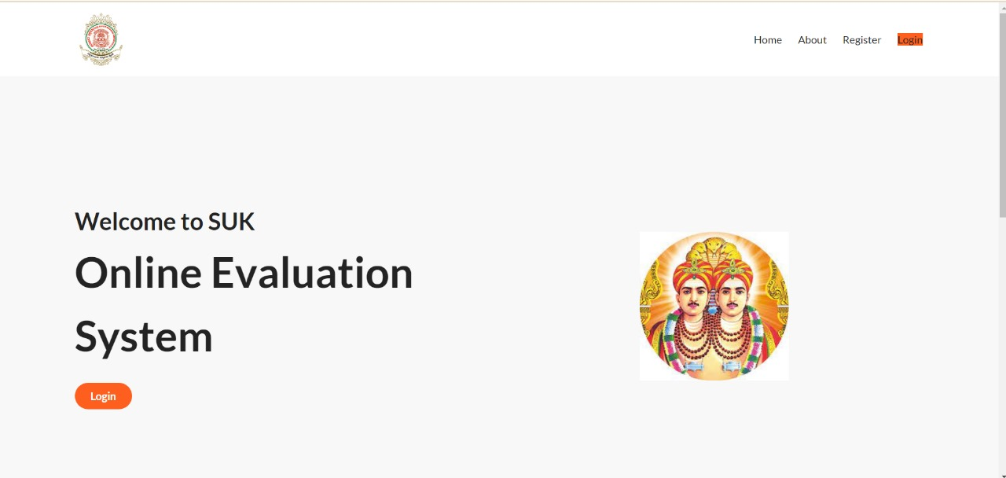
RESULT:

Slide 10
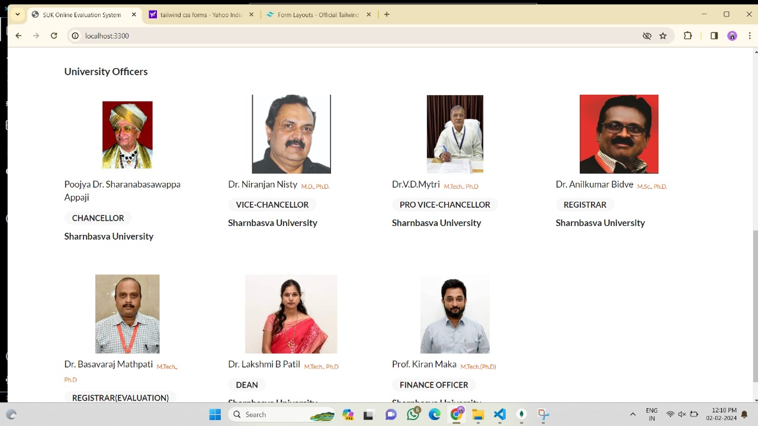

Slide 11
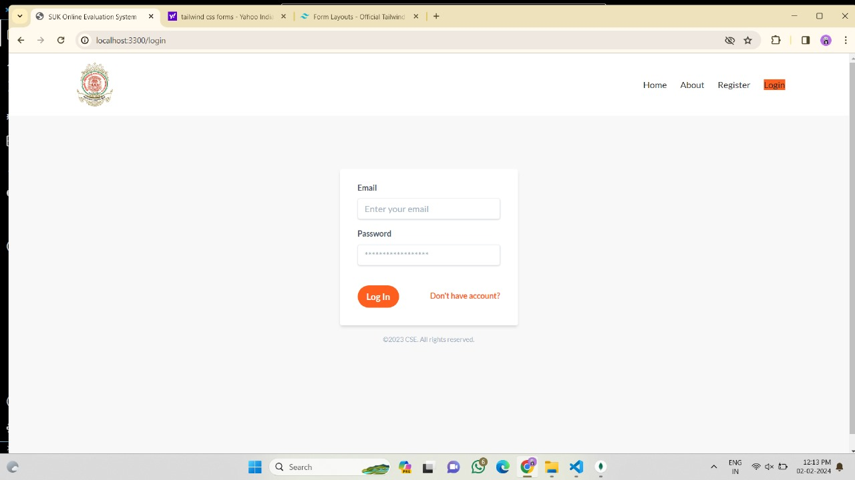
WHEN CLICKED ON LOGIN PAGE:

Slide 12
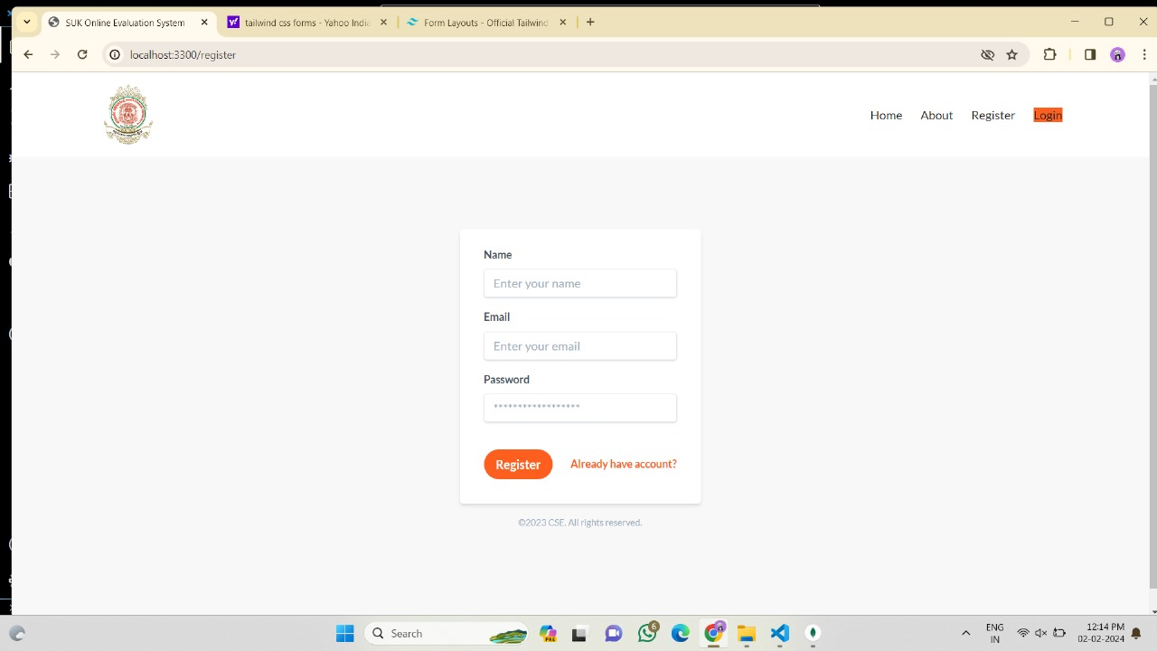
WHEN CLICKED ON REGISTER FORM :

Slide 13
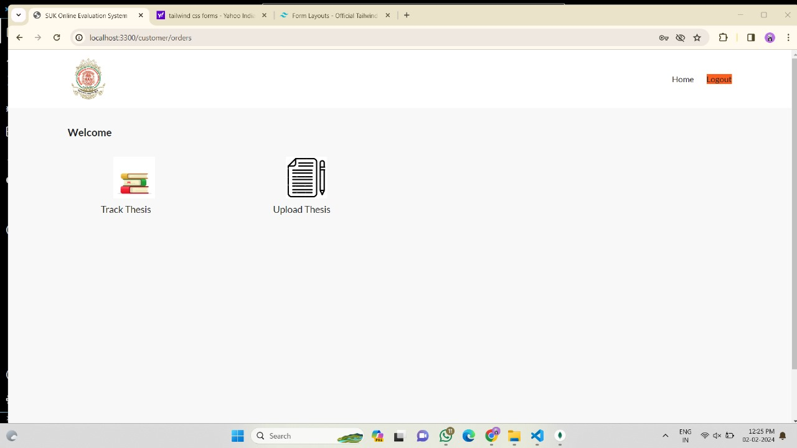

Slide 14
CONCLUSION :
This Project ensures to provide quick access to the faculty and university chairpersons to get the information about the marks and evaluation of the university examinatons.
This Project ensures to give a unique secret code to the faculty.
This Projects allows chairpersons and faculty to view and download the required data.
FUTURE WORK:
In Future, this project will consists of 3 login accounts, one for the Dean’s, one for the Chairperson’s and one for the faculty.
In Future, we are looking forward to create a backend support and link this website to a database where all the information will be stored in database.

Slide 15
REFERENCES :
References used in this Project are :
W3 schools - https://www.w3schools.com/html/
Wikipedia - https://en.wikipedia.org/wiki/HTML
https://en.wikipedia.org/wiki/CSS

